Slide 1
Airport Collaborative Decision Making
(A-CDM)
Saulo Da Silva
SIP/ASBU/2012-WP/15
Workshop on preparations for ANConf/12 − ASBU methodology
(Bangkok, 14-18/Nadi, 21-25 May 2012)

Slide 2
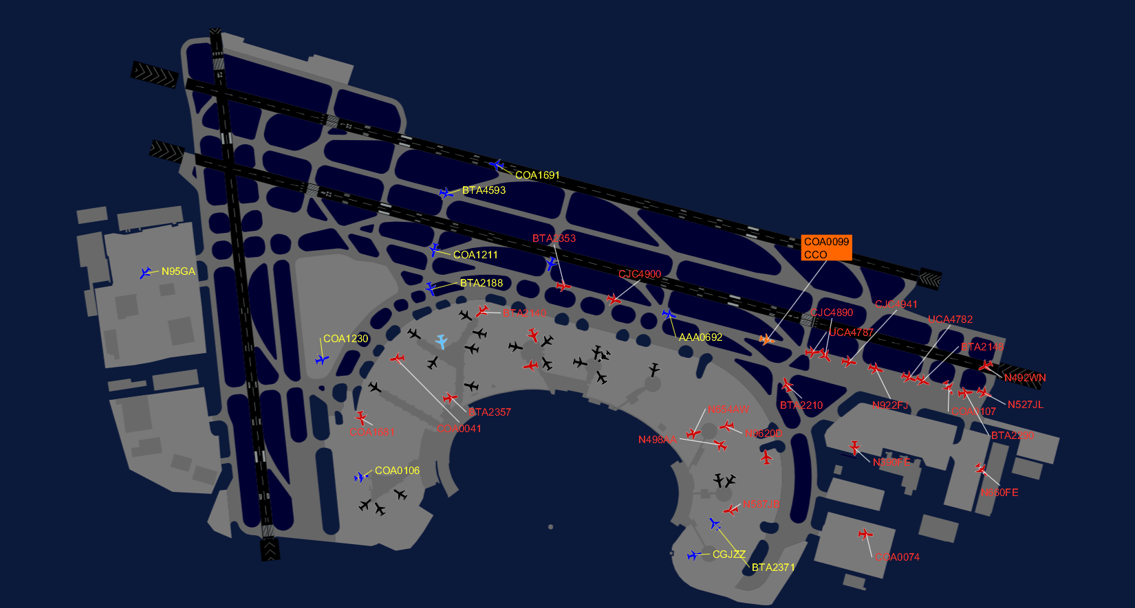
Objective
Show some steps to improve airport efficiency through the application of the A-CDM concept.

Slide 3
Overview
What is A-CDM
Benefits
Costs
Lessons learned

Slide 4
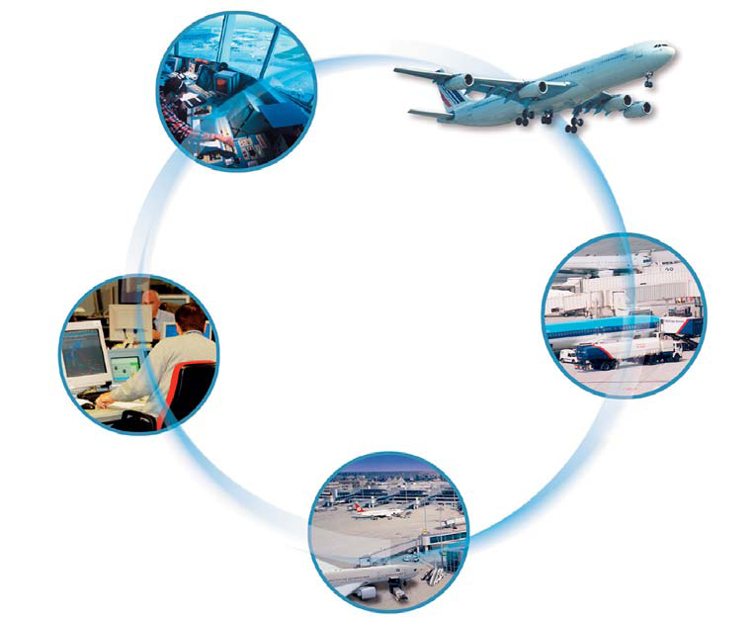
What is A-CDM?
Acting on shared information.
The right information at the right time to the right people

Slide 5
What is A-CDM?
Will request between the partners
1) Well defined Service Level Agreements
2) Non-disclosure Agreements
It will help to ensure that partners
■ provide high quality information
■ stick to their commitments
■ define appropriate access levels for sensitive information
■ share data only internally within Airport CDM
■ leave airlines with the right to decide which information they share with their passengers and which not

Slide 6
What is A-CDM?
What to share
■ airline schedules and flight planning information
■ predictions, status messages and operational planning information (stand, gate, landing time, in-block time, turn-round time)
■ advisories and alarms (e.g. insufficient time to complete turn-round)
■ status of aeronautical aids/systems and weather situation.

Slide 7
Understanding A-CDM
Waiting on the taxiway for an occupied stand
No ground staff or equipment to meet you
Sitting in the aircraft for a long time before leaving the stand
Wait until the last minute to inform that the aircraft is not ready and you will miss the connection

Slide 8
Understanding A-CDM
Airport CDM seeks to address these issues

Slide 9
Possible causes
Insufficient or unreliable information
No single partner has the complete picture
Accurate information is provided too late for a partner to be ready

Slide 10
Benefits of A-CDM
AIRLINES
Shorter taxi times, shorter holding before runway access
No waiting in front of occupied gate
Fuel savings
Reduced delays > cost savings and customer satisfaction
Increased capacity with the same fleet

Slide 11
Benefits of A-CDM
AIR TRAFFIC CONTROL
More predictable traffic - therefore reduced workload
Better pre-departure sequence
Higher service quality

Slide 12
Benefits of A-CDM
GROUND HANDLERS
Better planning and use of resources – therefore less cost, more profit
Improved customer satisfaction
Increased productivity – lower prices

Slide 13
Benefits of A-CDM
AIRPORT OPERATOR
Reduced environmental impacts – noise and emissions
Improved punctuality
Improved gate/stand planning and management
Additional flights and passengers possible

Slide 14
Benefits of A-CDM
REGULATORS
Safety and environmental benefits that can help meet targets
THE ATM NETWORK
More available en-route and airport capacity

Slide 15
Benefits of A-CDM
EVERYONE!
Reduced apron and taxiway congestion
Mutual understanding and trust
Less stress on the system and the people within it
Higher service quality with knock-on benefits to company image and customer satisfaction

Slide 16

Benefits of A-CDM
For a generic airport:
Benefit-to-cost ratio of up to 9/1
Quick return of investment for all partners – 2 years
Risk of financial loss is practically non existent
There is a very strong case for implementing Airport CDM
Benefit
Cost

Slide 17

Benefits of A-CDM
Airport operators are on top, followed by
airlines and ground handling
companies
ATC will see the smallest quantifiable
benefit, but will see major qualitative
improvements in work processes.

Slide 18
Summary of Costs
One-off Costs:
Project definition & project management
Procedures adaptation
System integration
Staff training

Slide 19
Summary of Costs
Operating Costs:
Maintenance & IT Improvements
Recurrent training
Travel costs
Airlines: full time function – ATC/FLOW, flight dispatch staffing

Slide 20
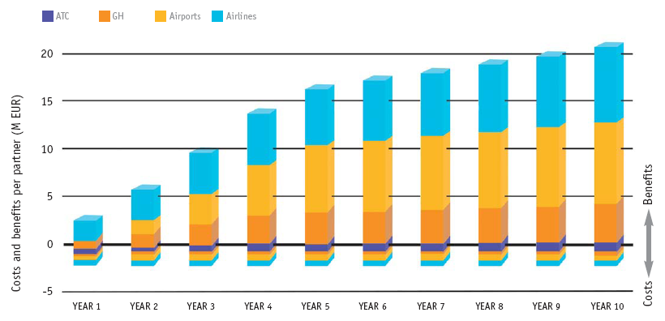
Costs and benefits per partner

Slide 21
The key
Improved predictability
“Out of every extra 100 kg of fuel loaded on the aircraft to
accommodate ‘buffers’ in schedules, 4% per hour will be burned just in carrying the weight of that fuel.”
IATA

Slide 22
Lessons learned
“It started as a part time job but we couldn’t do it like that. IT IS A FULL TIME JOB!!!”
“Airport CDM is a process. Sure, you have to have the IT systems - but first, you need to know what to do with it.”
“You must have a clear understanding of what you are going to implement before you proceed. Without a clear link between the process improvement and the required information, people will remain reluctant to share this information.”

Slide 23


